Slide 1
CONTENT RECOMMENDATION SYSTEM
Submitted By:
Tushar Sehdev
Museib Patel
Mohd Abdul Ghani
Dhatchana Moorthy Mathan
Submitted To: F13 Technologies

Slide 2
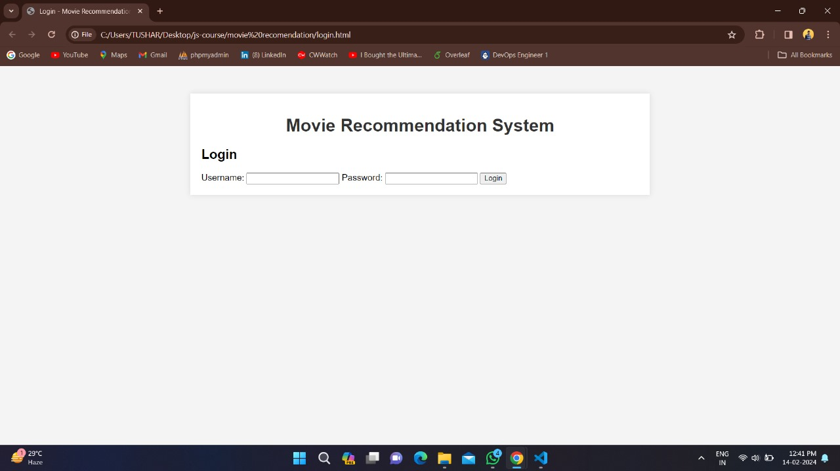
INTRODUCTION
A content recommendation system enhances user experience by offering personalized suggestions based on preferences and behavior. AWS Personalize is a managed machine learning service that enables easy development of custom content recommendation systems. It uses advanced algorithms to analyze user data and improve recommendation quality through real-time updates and A/B testing. This innovative system aims to revolutionize service recommendations in the digital era.

Slide 3
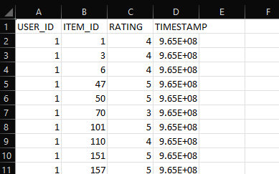
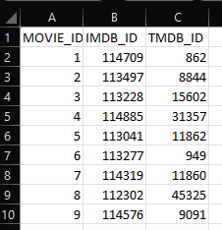
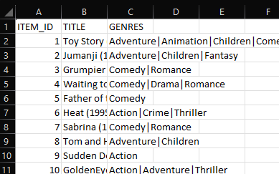
OUTLINE OF CRS
During data processing, the Movie Lens dataset is structured into links, movies, and ratings files. The links file links movie IDs to external sources, the movies file contains metadata like title and genre, and the ratings file includes user-generated ratings. This organized data aids in tasks such as developing recommendation systems and understanding user behavior.

Slide 4
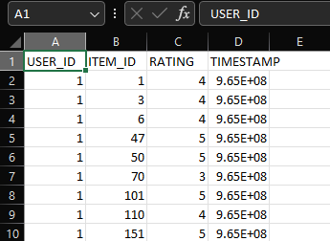
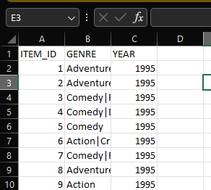
Data Pre-Processing:
The data preprocessing for the CRS involved creating a sample dataset with user-item interaction data like USER_ID, ITEM_ID, TIMESTAMP, and EVENT_TYPE. The data was preprocessed from Movie Lens data files using Python to make it suitable for deployment and import.

Slide 5
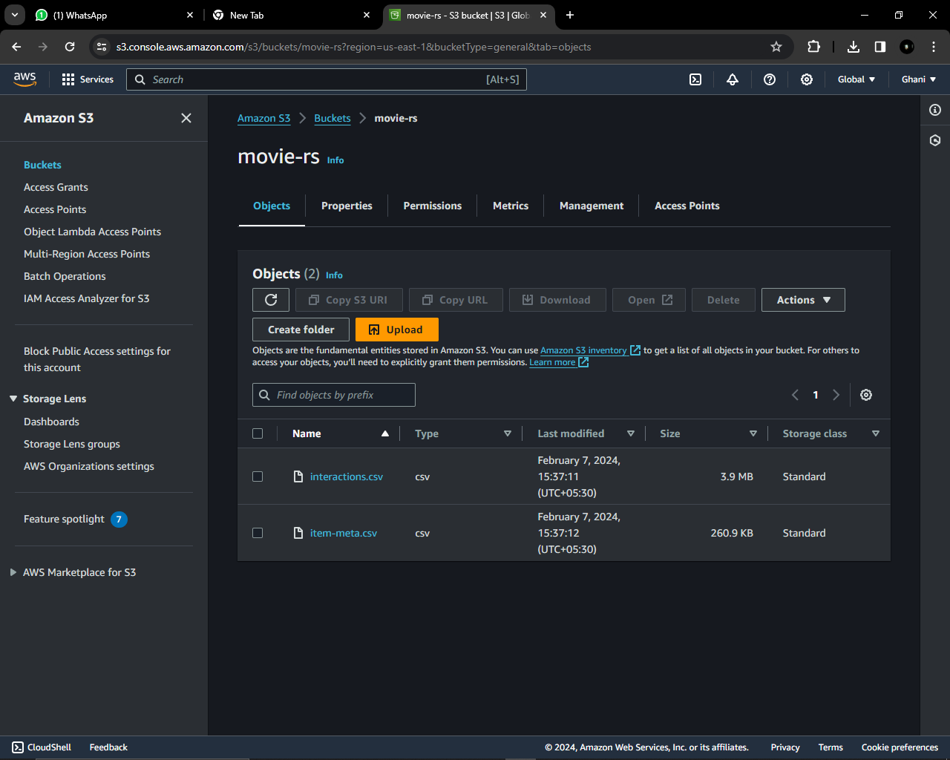
Data Processing:
This dataset was then uploaded to AWS S3 for storage. And then connect that S3 bucket movie-rs to AWS Personalize for CSR.

Slide 6
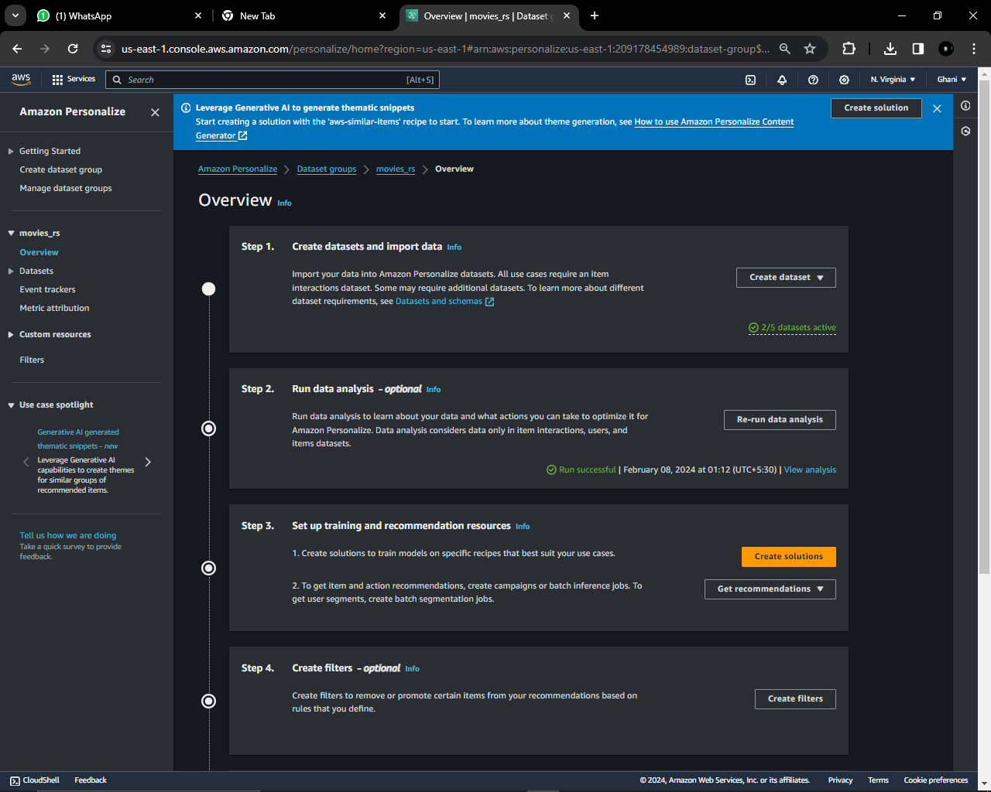
Aws Personalize:
Now we create a Data set in AWS Personalize, here first step we create a Dataset group with name “movies_rs” in which we import the dataset in .csv
from s3 bucket of movies-rs.

Slide 7
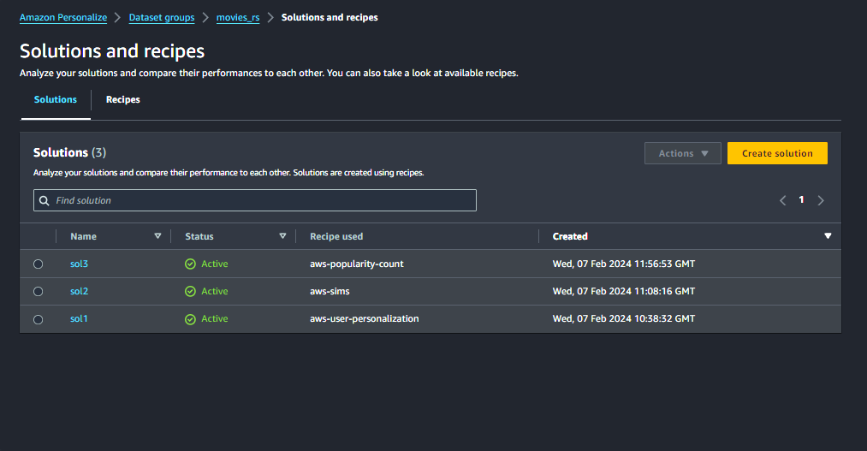
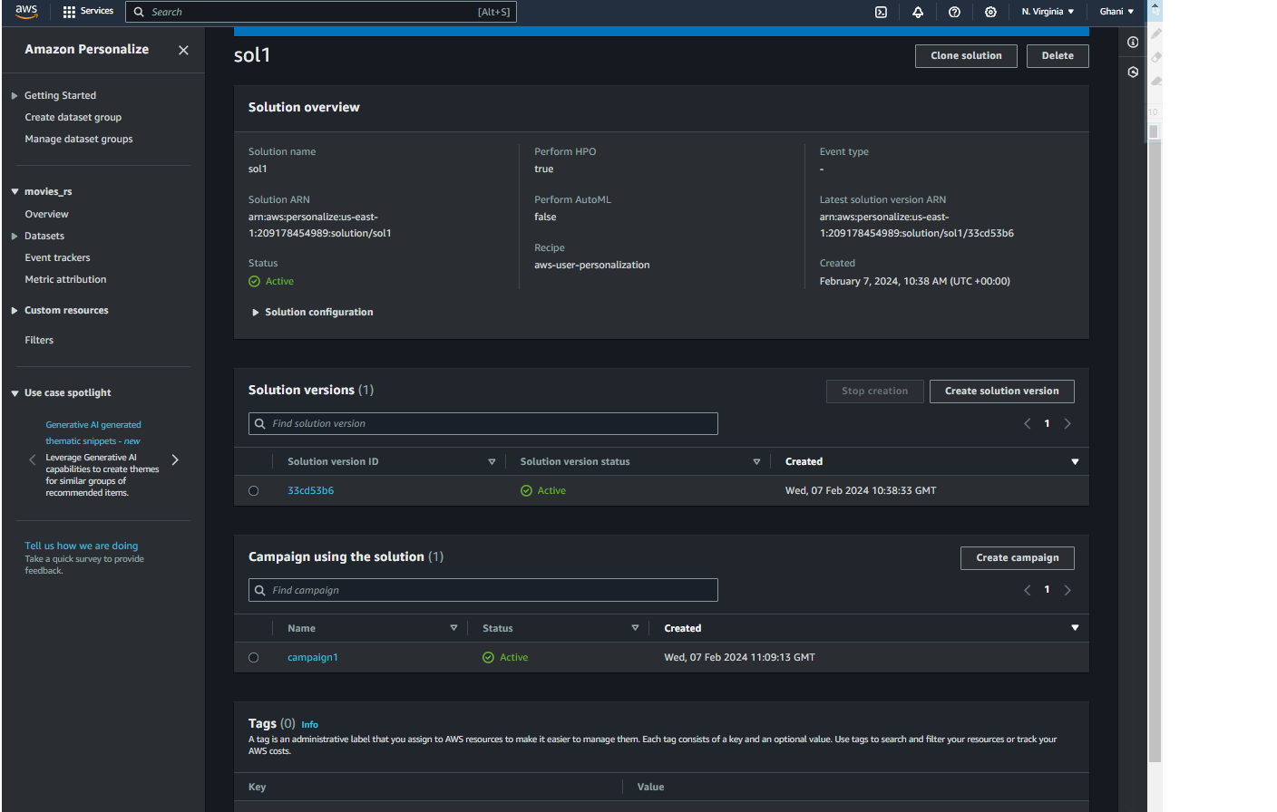
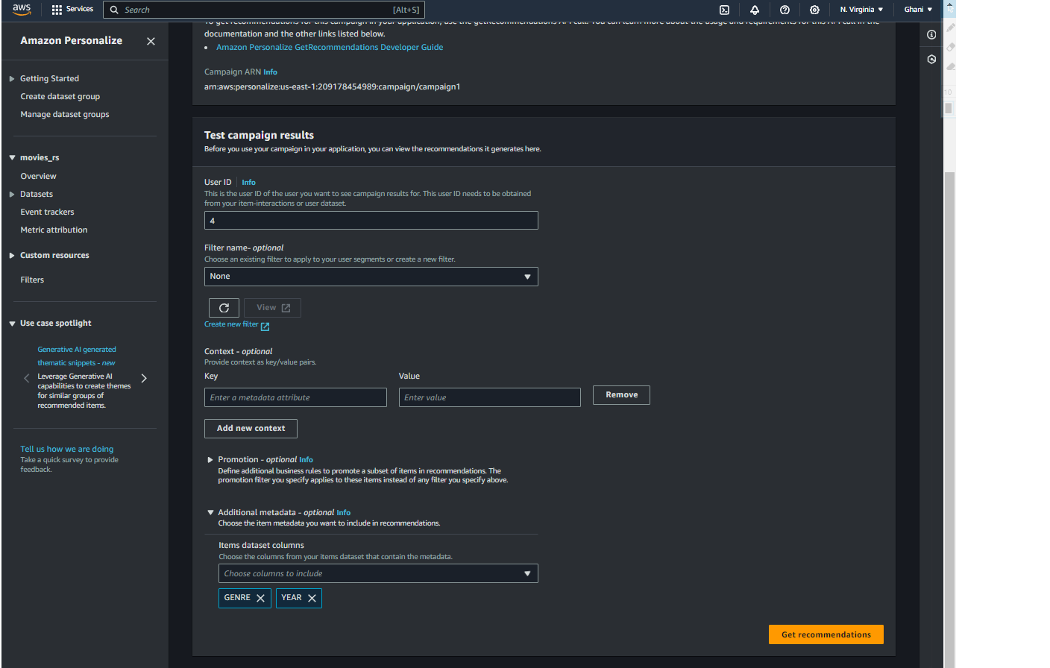
Solution & Recipe:
In this phase, we generate solutions by selecting from a set of predefined recipes available in AWS. We choose the appropriate recipe for each of the three solutions we have created.
Running Campaign:
In this phase we create a campaign to the solution, configure settings such as campaign budget, duration, target audience, geographic targeting, etc., depending on your campaign requirements. Start the campaign by deploying your resources and activating your advertising or promotional content. Make necessary adjustments to your campaign settings or resources to optimize performance based on real-time data analysis.

Slide 8
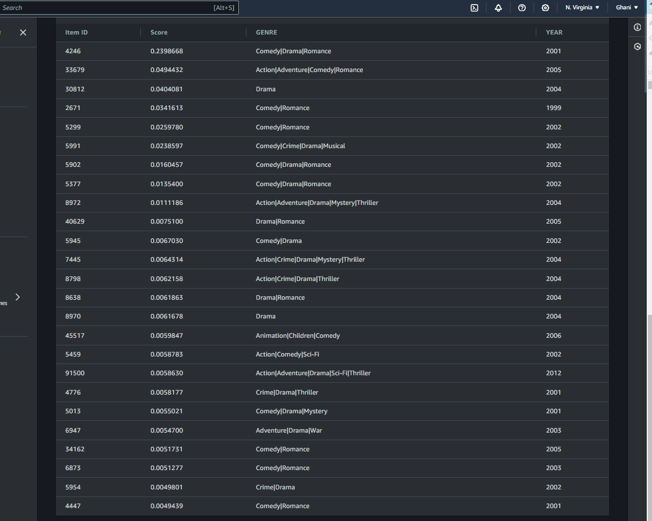
Testing
Now set the target audience parameters. Then, deploy resources, activate promotional content, and monitor performance metrics to optimize results effectively.

Slide 9
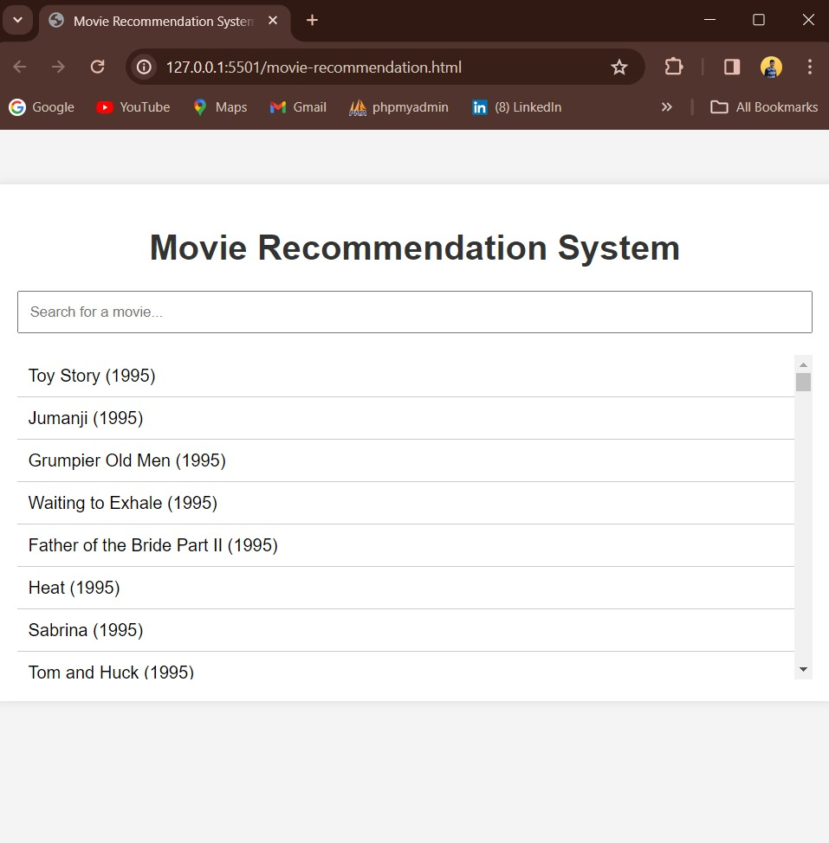
Website Development:
We have created website development process, emphasizing the use of Git for version control and incorporating Node.js modules and CSS for website styling.
Preference and Behavior:
User preferences and behavior are captured implicitly through the system's interactions. When a user selects or engages with a service, the CRS can record this behavior and use it to refine recommendations. However, this report does not cover the explicit mechanisms for collecting user data.
The camp1: Precision At 5 0.0679 At 10 0.0482 At 25 0.0314 The camp2: Precision At 5 0.0676 At 10 0.0426 At 25 0.0259 The camp3: Precision At 5 0.0116 At 10 0.0116 At 25 0.0099 In this we see precision speed of camp1 is high so we are using solution1 for our website.

Slide 10

Architecture Diagram

Slide 11
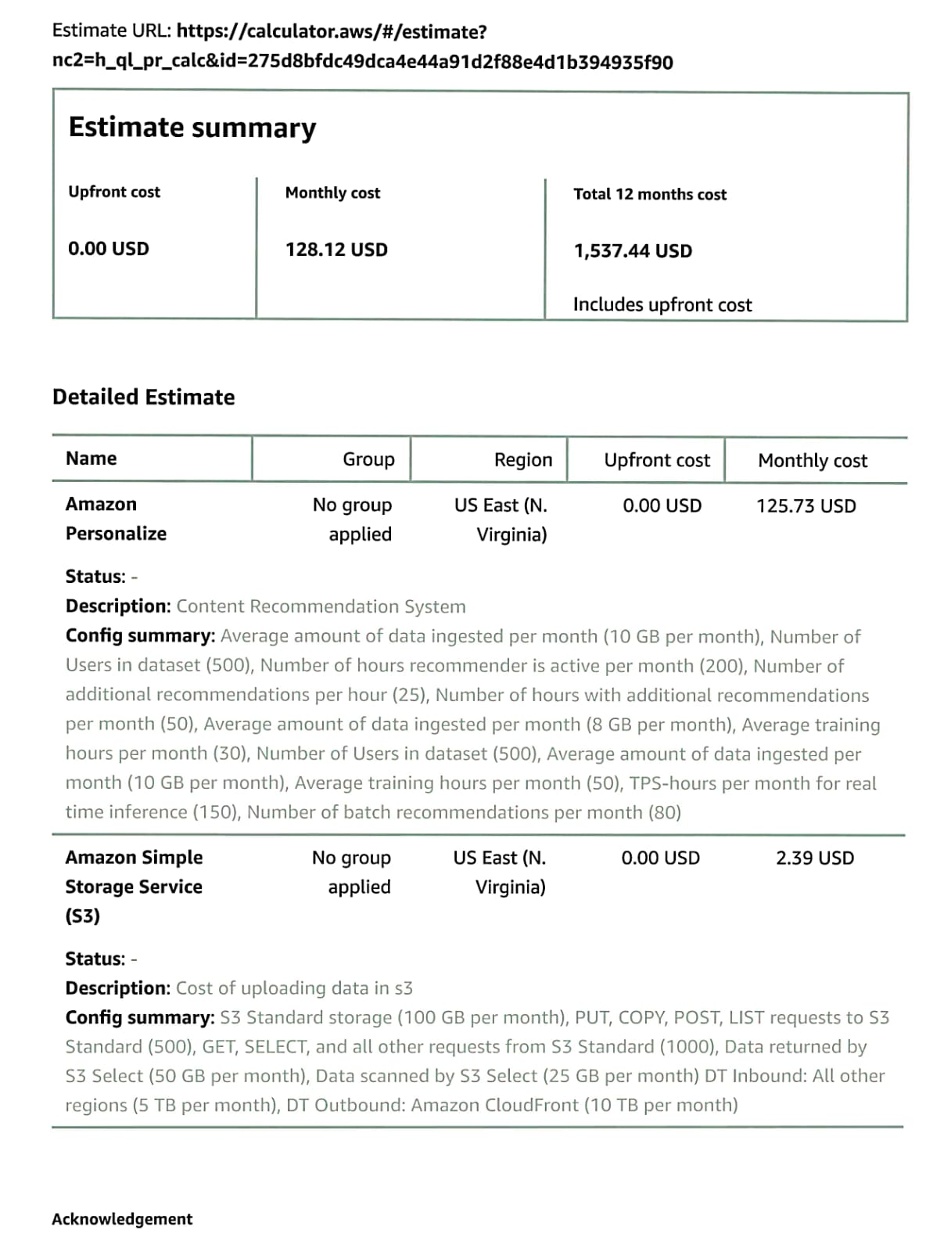
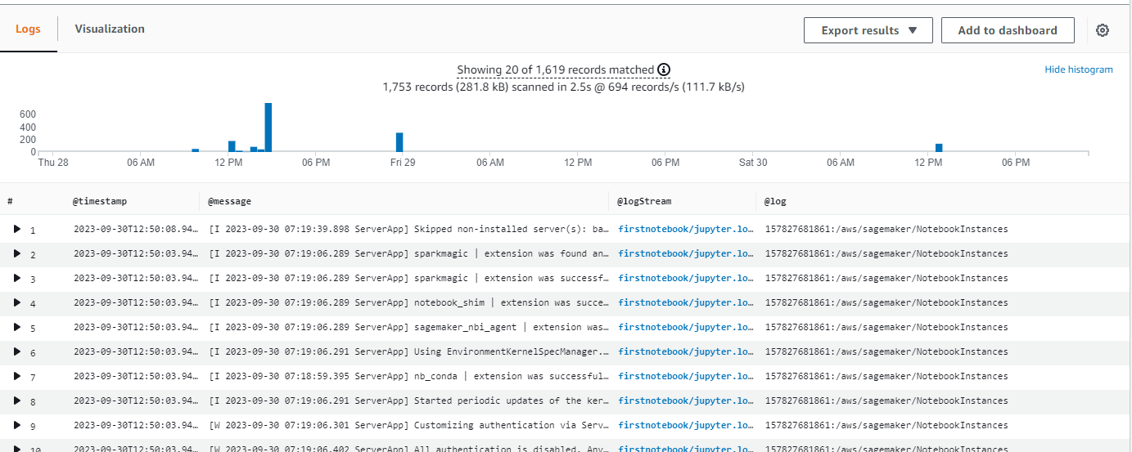
Cost Analysis
Performance Analysis

Slide 12
Aws services Used
Amazon S3 (Simple Storage Service):
Amazon S3 is an object storage service provided by Amazon Web Services (AWS). It is designed to store and retrieve vast amounts of data securely and cost- effectively. S3 offers scalable, durable, and highly available storage, making it a popular choice for storing various types of data, including files, images, videos, and datasets.
Amazon Route 53: Amazon Route 53 is an AWS-provided scalable Domain Name System (DNS) service, translating domain names into IP addresses for efficient internet connectivity.
Amazon EC2 (Elastic Compute Cloud): Amazon EC2 is a core AWS service that provides resizable compute capacity in the cloud. It allows you to create and manage virtual servers known as EC2 instances.
IAM User (Identity and Access Management User):
An IAM User is a persona within AWS Identity and Access Management (IAM) that represents an individual entity or application requiring access to AWS resources
Amazon CloudWatch: Amazon CloudWatch in a personalized recommendation system implemented using AWS Personalize, operators can effectively monitor, troubleshoot, and optimize the system's performance and reliability, ensuring a seamless and personalized user experience

Slide 13
In-Depth Analysis of SKY Content Recommendation System
Introduction:
Content Recommendation Systems (CRS) have become an integral part of many online platforms, aiding users in discovering relevant content in the vast sea of options. In this report, we will delve into the workings of an existing CRS by examining Sky’s recommendation system. We will analyze its features, architecture, algorithms employed, and overall effectiveness.
Sky’s recommendation system overview:
Sky, a European media and telecommunications company, employs a sophisticated recommendation system powered by AWS Personalize to enhance user engagement and satisfaction across its platforms.
a. Personalization: Sky's content recommendation system tailors’ suggestions for individual users by analyzing their viewing history, preferences, and interactions across the platform.
b. Diverse Recommendation Types: Sky provides recommendations spanning various content categories such as TV shows, movies, documentaries, and sports events, catering to a broad audience.
c. Discovery and Surprise: The system balances familiar suggestions with unexpected content choices, encouraging users to explore new shows and genres.
d. Individual Profiles: Sky allows multiple user profiles within a single account, with each profile receiving personalized recommendations based on its unique viewing patterns.

Slide 14
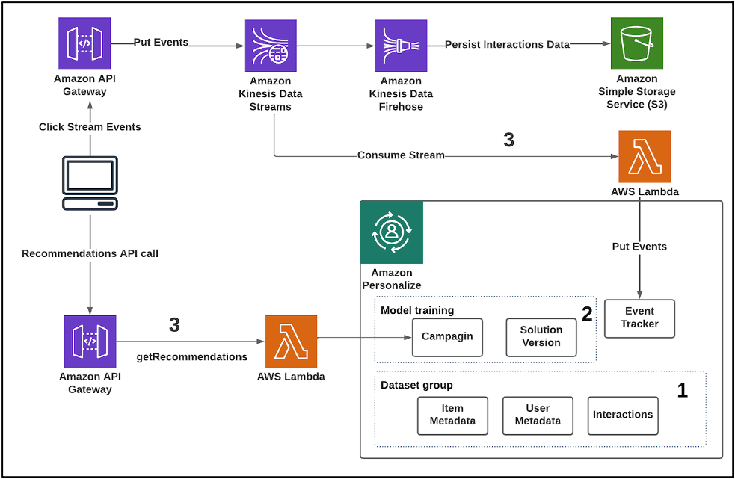
Architecture: Sky's content recommendation system architecture likely involves multiple components: Data Ingestion: Integration with various data sources such as user interaction data, content metadata, and contextual information. Data Processing: Pre-processing of raw data to extract features, transform data into suitable formats, and perform data cleaning tasks. Model Training: Utilization of AWS Personalizes machine learning algorithms to train recommendation models based on historical user behavior and content attributes. Model Deployment: Deployment of trained models to generate real-time recommendations for users across Sky's platforms. Feedback Loop: Integration of user feedback mechanisms to continuously update and refine recommendation models.

Slide 15
Algorithms Employed:
Sky's CRS utilizes several recommendation algorithms, including:
Sky likely employs a variety of machine learning algorithms provided by AWS Personalize, such as:
a) Collaborative Filtering: Analyzing user interactions and similarities to recommend content based on similar user preferences.
b) User Personalization: Building personalized recommendation models tailored to individual user preferences and behavior.
c) Item-to-Item Recommendations: Recommending similar items based on content attributes and user preferences.
d) Contextual Bandits: To consider temporal and situational context in recommendations.
These algorithms are trained using historical data and optimized to provide accurate and relevant recommendations to Sky's users.

Slide 16
Overall Effectiveness: Sky's recommendation system is highly effective and plays a pivotal role in retaining subscribers. It is estimated that over 80% of the content watched on Sky’s is driven by recommendations. The system's success can be attributed to its ability to: Understand User Behavior: Sky comprehensively analyzes user behavior, including viewing history, time of day, and device used. Adapt in Real-Time: Recommendations are updated frequently to reflect user interactions, leading to continuous improvement. Balance Exploration and Exploitation: The system encourages users to explore new content while also catering to their known preferences. Handle Cold Start Problem: Sky effectively addresses the "cold start" problem for new users by leveraging content-based recommendations initially.

Slide 17
Conclusion:
Sky's content recommendation system serves as an exemplary case study of a hybrid recommendation system's capabilities. Its personalized, real-time, and adaptable nature makes it a powerful tool for content discovery, contributing significantly to user satisfaction and platform success. The combination of collaborative filtering, content-based filtering, and machine learning algorithms forms the backbone of this highly effective system, providing valuable insights for the field of recommendation systems.
References
Amazon.com
YouTube
LinkedIn
Tools Used
MS Office
VS. Code
Adobe Acrobat
MS Excel
Chat GPT

Slide 18
THANK YOU.

